Slide 1


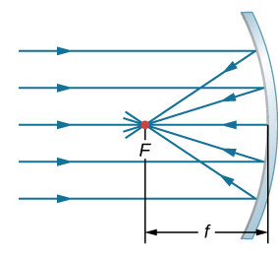
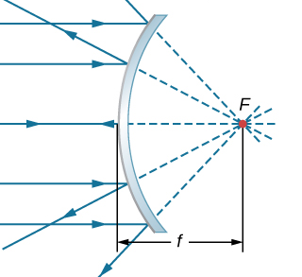





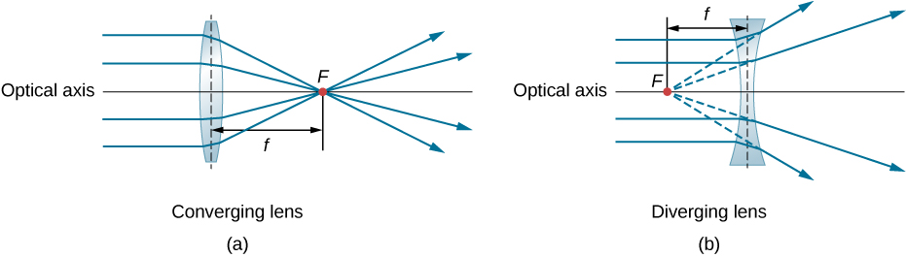
11
Light – Ray Optics
Ray Model of Light
Light travels along straight lines at speed v = c/n, where n is the index of refraction. The light continues forever unless it interacts with matter; two common ways to interact are reflection and refraction.
An object is a source of light rays.
Spherical Surfaces
Spherical Mirrors
A spherical mirror can form a real or virtual image with location s’ given by the mirror equation,
where f = R/2 is the focal length and R is the radius of curvature. The lateral magnification is given by
Sign conventions: R and f are positive for a concave mirror. s' is positive for a real image.
Concave mirror Convex mirror
n₁
n₂
Reflection
Refraction
The ray model is valid when lenses, mirrors, and apertures are larger than about 1 mm.
Reflection
The law of reflection states that the reflected angle is equal to the angle of incidence. All angles are measured with respect to the normal.
θ_{i}
θ_{r}
Refraction
The law of refraction states that
If n₂ < n₁, total internal reflection (TIR) occurs when θ ₁ is greater than the critical angle,
n₁
θ₁
n₂
θ₂
Refraction
A spherical surface can form a real or virtual image, with object and image distance related by
Thin Lenses
A thin lens can form a real or virtual image with location s’ given by
The lateral magnification is given by
The focal length f is given by the lens maker’s equation,
Sign conventions: R is positive for a surface convex toward the object. f is positive for a converging lens. s' is positive for a real image.
Converging lens Diverging lens
Plane Surfaces
Reflection
A virtual image is formed at P’ with an image distance s’ equal to the object distance s.
Refraction
A virtual image is formed at P’, where the image distance s’ is related to the object distance s by
Object
s
s’
P’
Image
P
n₁
n₂
P’
Object
P
s’
Image
s
Electricity and Magnetism
Joseph D. MacMillan | Licensed under CC BY-NC-SA 4.0.

